Slide 1
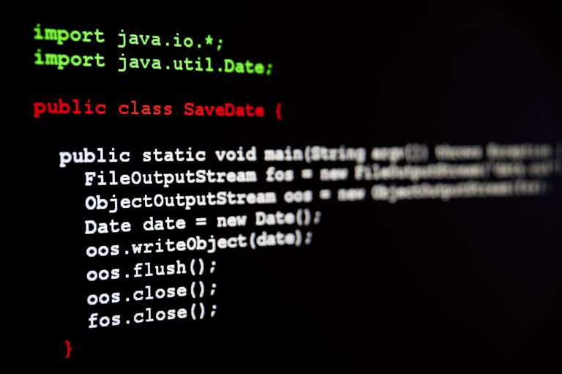








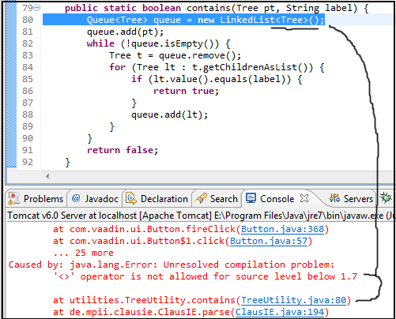

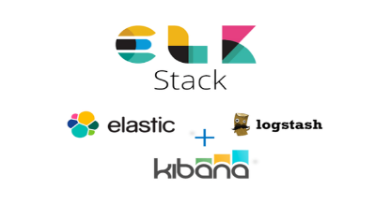
DevOps
CICD
CD CONTINOUS DELIVERY
VERSION CONTROL (GIT)
DEVELOPER WRITES CODE
&
UNIT TEST
CI CONTINOUS INTEGRATION
CONTINOUS DEPLOYMENT
CO
CONTINOUS MONITORING
INTEGRATION TESTING
CODE COMPILE

Slide 2



I want
“Vote Now” Button below the image
ONCE UPON A TIME THERE WAS A
WEBSITE
Sure
DEVELOPER

Slide 3


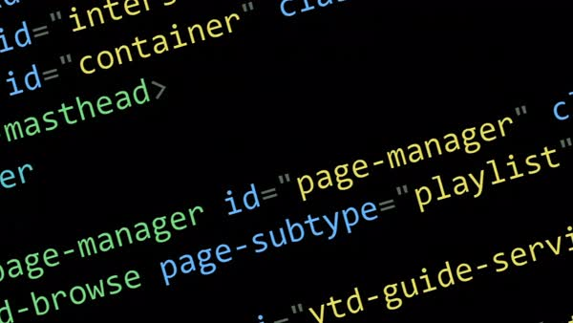
THE DEVELOPER GETS TO WORK
WAR PACKAGE
MAKES CODE CHANGES

Slide 4


I Don’t like the button. Remove It!
OK

Slide 5
THE DEVELOPER GETS TO WORK AGAIN
WAR PACKAGE
MAKES CODE CHANGES

Slide 6

I THOUGHT ABOUT IT I THINK IT IS BETTER WE HAVE THE
“VOTE NOW”
BUTTON
OK

Slide 7
THE DEVELOPER GETS TO WORK AGAIN
WAR PACKAGE
MAKES CODE CHANGES

Slide 8

TAG: WITH_BUTTON 1a5eb8b4
TAG: WITHOUT_BUTTON c1e4be4b
MAKES CODE CHANGES

Slide 9

NO BUTTON!
I WANT BUTTON
TAG: WITH_BUTTON 1a5eb8b4
TAG: WITHOUT_BUTTON c1e4be4b
OK

Slide 10
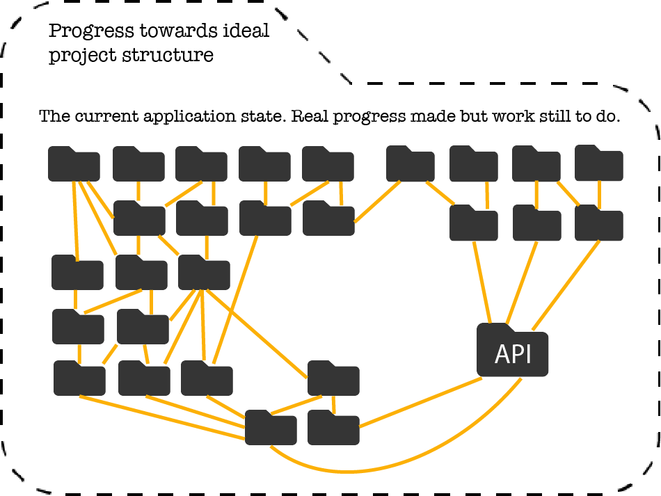
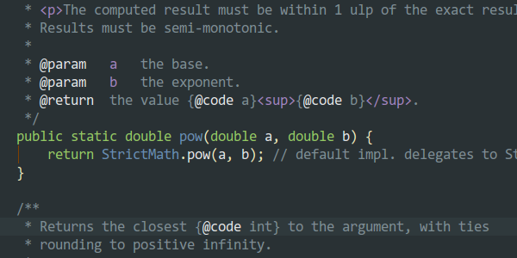


String name = getParameter("myName");
if ( name.startsWith(“iron") ){
print("THIS PERSON IS IRONMAN");
}
String name = getParameter("myName");
if ( name.startsWith("super") ){
print("THIS PERSON IS SUPERMAN");
}
Utility.java
String name = getParameter("myName");
if ( name.startsWith("super") ){
print("THIS PERSON IS SUPERMAN");
}
String name = getParameter("myName");
if ( name.startsWith(“iron") ){
print("THIS PERSON IS IRONMAN");
}
Utility.java
Utility.java

Slide 11
String name = getParameter("myName");
if ( name.startsWith("super") ){
System.out.println("THIS PERSON IS SUPERMAN");
}
if ( name.startsWith(“iron") ){
System.out.println("THIS PERSON IS IRONMAN");
}
String name = getParameter("myName");
if ( name.startsWith("super") ){
System.out.println("THIS PERSON IS SUPERMAN");
}
String name = getParameter("myName");
if ( name.startsWith(“iron") ){
System.out.println("THIS PERSON IS IRONMAN");
}

Slide 12




REMOTE REPO
git commit
git add
git pull
git clone
git push
WORK DIR
STAGING
LOCAL REPO
DEVELOPER A
DEVELOPER B
Notes:
git config --global user.name "Jitendra A“
git config --global user.email "jiten@edureka.com“
git config –list
By default, the git push command doesn’t transfer tags to remote servers.
git push origin v1.5
git push origin –tags
Delete tags
git tag -d v1.4-lw
Git checkout
git checkout 2.0.0
git checkout -b version2 v2.0.0

Slide 13

MASTER
BRANCH 1
BRANCH 2
Let the 3 files in red, green and blue be 3 java files

Slide 14
MASTER
BRANCH 1
BRANCH 1
git merge
Let red, green, blue and yellow be 4 java files

Slide 15
MERGE CONFLICT
MASTER
BRANCH 1
1 # Store input numbers
2 num1 = input('Enter first number: ')
3 num2 = input('Enter second number: ')
4
5 # Add two numbers
6 sum = float(num1) + float(num2)
7
8 # Display the sum
9 print('The sum’+sum)
1 # Store input numbers
2 num1 = input('Enter 1st number: ')
3 num2 = input('Enter 2nd number: ')
4
5 # Add two numbers
6 sum = float(num1) + float(num2)
7
8 # Display the sum
9 print('The sum’+sum)

Slide 16
MERGE CONFLICT
MASTER
BRANCH 1
1 # Store input numbers
2 num1 = input('Enter 1st number: ')
3 num2 = input('Enter 2nd number: ')
4
5 # Add two numbers
6 sum = float(num1) + float(num2)
7
8 # Display the sum
9 print('The sum’+sum)
1 # Store input numbers
2 num1 = input('Enter first number: ')
3 num2 = input('Enter second number: ')
4
5 # Add two numbers
6 sum = float(num1) + float(num2)
7
8 # Display the sum
9 print('The sum’+sum)
1 # Store input numbers
2 num1 = input('Enter 1st number: ')
3 num2 = input('Enter 2nd number: ')
4
5 # Add two numbers
6 sum = float(num1) + float(num2)
7
8 # Display the sum
9 print('The sum’+sum)
NO CHANGE IN MASTER

Slide 17
MERGE CONFLICT
MASTER
BRANCH 1
1 # Store input numbers
2 num1 = input('Enter first number: ')
3 num2 = input('Enter second number: ')
4
5 # Add two numbers
6 sum = float(num1) + float(num2)
7
8 # Display the sum
9 print('The sum’+sum)
1 # Store input numbers
2 num1 = input('Enter 1st number: ')
3 num2 = input('Enter 2nd number: ')
4
5 # Add two numbers
6 sum = float(num1) + float(num2)
7
8 # Display the sum
9 print('The sum’+sum)
1 # Store input numbers
2 num1 = input('Enter first number: ')
3 num2 = input('Enter second number: ')
4
5 # Add two numbers
6 sum = float(num1) + float(num2)
7
8 # Display the sum
9 print('The sum’+sum)

Slide 18
MERGE CONFLICT
MASTER
BRANCH 1
1 # Store input numbers
2 num1 = input('Enter first number: ')
3 num2 = input('Enter second number: ')
4
5 # Add two numbers
6 sum = int(num1) + int(num2)
7
8 # Display the sum
9 print('The sum’+sum)
1 # Store input numbers
2 num1 = input('Enter 1st number: ')
3 num2 = input('Enter 2nd number: ')
4
5 # Add two numbers
6 sum = float(num1) + float(num2)
7
8 # Display the sum
9 print('The sum’+sum)
1 # Store input numbers
2 num1 = input('Enter first number: ')
3 num2 = input('Enter second number: ')
4
5 # Add two numbers
6 sum = float(num1) + float(num2)
7
8 # Display the sum
9 print('The sum’+sum)
THE IS CHANGE IN MASTER

Slide 19
MERGE CONFLICT
MASTER
BRANCH 1
1 # Store input numbers
2 num1 = input('Enter 1st number: ')
3 num2 = input('Enter 2nd number: ')
4
5 # Add two numbers
6 sum = int(num1) + int(num2)
7
8 # Display the sum
9 print('The sum’+sum)
1 # Store input numbers
2 num1 = input('Enter 1st number: ')
3 num2 = input('Enter 2nd number: ')
4
5 # Add two numbers
6 sum = float(num1) + float(num2)
7
8 # Display the sum
9 print('The sum’+sum)
1 # Store input numbers
2 num1 = input('Enter first number: ')
3 num2 = input('Enter second number: ')
4
5 # Add two numbers
6 sum = int(num1) + int(num2)
7
8 # Display the sum
9 print('The sum’+sum)
1 # Store input numbers
2 num1 = input('Enter 1st number: ')
3 num2 = input('Enter 2nd number: ')
4
5 # Add two numbers
6 sum = float(num1) + float(num2)
7
8 # Display the sum
9 print('The sum’+sum)
THE IS CHANGE IN MASTER AFTER BRANCH CREATION

Slide 20
MERGE CONFLICT - REBASE
MASTER
BRANCH 1
1 # Store input numbers
2 num1 = input('Enter first number: ')
3 num2 = input('Enter second number: ')
4
5 # Add two numbers
6 sum = int(num1) + int(num2)
7
8 # Display the sum
9 print('The sum’+sum)
1 # Store input numbers
2 num1 = input('Enter 1st number: ')
3 num2 = input('Enter 2nd number: ')
4
5 # Add two numbers
6 sum = int(num1) + int(num2)
7
8 # Display the sum
9 print('The sum’+sum)
1 # Store input numbers
2 num1 = input('Enter first number: ')
3 num2 = input('Enter second number: ')
4
5 # Add two numbers
6 sum = int(num1) + int(num2)
7
8 # Display the sum
9 print('The sum’+sum)
1 # Store input numbers
2 num1 = input('Enter 1st number: ')
3 num2 = input('Enter 2nd number: ')
4
5 # Add two numbers
6 sum = float(num1) + float(num2)
7
8 # Display the sum
9 print('The sum’+sum)
THE IS CHANGE IN MASTER AFTER BRANCH CREATION

Slide 21
MERGE CONFLICT - REBASE
MASTER
BRANCH 1
1 # Store input numbers
2 num1 = input('Enter first number: ')
3 num2 = input('Enter second number: ')
4
5 # Add two numbers
6 sum = int(num1) + int(num2)
7
8 # Display the sum
9 print('The sum’+sum)
1 # Store input numbers
2 num1 = input('Enter 1st number: ')
3 num2 = input('Enter 2nd number: ')
4
5 # Add two numbers
6 sum = int(num1) + int(num2)
7
8 # Display the sum
9 print('The sum’+sum)
1 # Store input numbers
2 num1 = input('Enter 1st number: ')
3 num2 = input('Enter 2nd number: ')
4
5 # Add two numbers
6 sum = int(num1) + int(num2)
7
8 # Display the sum
9 print('The sum’+sum)
THE IS CHANGE IN MASTER AFTER BRANCH CREATION

Slide 22
MERGE CONFLICT DURING - REBASE
MASTER
BRANCH 1
1 # Store input numbers
2 num1 = input('Enter first number: ')
3 num2 = input('Enter second number: ')
4
5 # Add two numbers
6 sum = float(num1) + float(num2)
7
8 # Display the sum
9 print('The sum’+sum)
1 # Store input numbers
2 num1 = input('Enter 1st number: ')
3 num2 = input('Enter 2nd number: ')
4
5 # Add two numbers
6 sum = int(num1) + int (num2)
7
8 # Display the sum
9 print('The sum’+sum)
1 # Store input numbers
2 num1 = input('Enter Numset1: ')
3 num2 = input('Enter Numset2: ')
4
5 # Add two numbers
6 sum = int(num1) + int(num2)
7
8 # Display the sum
9 print('The sum’+sum)
1 # Store input numbers
2 num1 = input('Enter Numset1: ')
3 num2 = input('Enter Numset2: ')
4
5 # Add two numbers
6 sum = int(num1) + int(num2)
7
8 # Display the sum
9 print('The sum’+sum)
1 # Store input numbers
2 num1 = input('Enter 1st number: ')
3 num2 = input('Enter 2nd number: ')
4
5 # Add two numbers
6 sum = float(num1) + float(num2)
7
8 # Display the sum
9 print('The sum’+sum)
1 # Store input numbers
2 num1 = input('Enter first number: ')
3 num2 = input('Enter second number: ')
4
5 # Add two numbers
6 sum = float(num1) + float(num2)
7
8 # Display the sum
9 print('The sum’+sum)
THE IS CHANGE IN MASTER AFTER BRANCH CREATION

Slide 23
MERGE CONFLICT - REBASE
MASTER
BRANCH 1
1 # Store input numbers
2 num1 = input('Enter first number: ')
3 num2 = input('Enter second number: ')
4
5 # Add two numbers
6 sum = int(num1) + int(num2)
7
8 # Display the sum
9 print('The sum’+sum)
1 # Store input numbers
2 num1 = input('Enter 1st number: ')
3 num2 = input('Enter 2nd number: ')
4
5 # Add two numbers
6 sum = int(num1) + int(num2)
7
8 # Display the sum
9 print('The sum’+sum)
1 # Store input numbers
2 num1 = input('Enter first number: ')
3 num2 = input('Enter second number: ')
4
5 # Add two numbers
6 sum = int(num1) + int(num2)
7
8 # Display the sum
9 print('The sum’+sum)
1 # Store input numbers
2 num1 = input('Enter 1st number: ')
3 num2 = input('Enter 2nd number: ')
4
5 # Add two numbers
6 sum = float(num1) + float(num2)
7
8 # Display the sum
9 print('The sum’+sum)
THE IS CHANGE IN MASTER AFTER BRANCH CREATION

Slide 24
MASTER
BRANCH 1
git rebase
Let red, green, blue and yellow be 4 java files

Slide 25

Computer understands only 0’s and 1’s

Slide 26
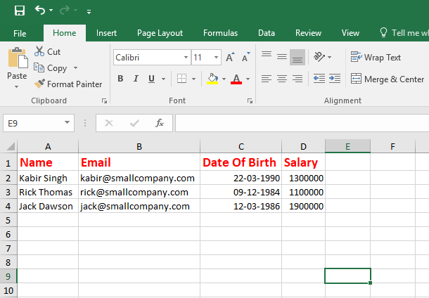

Create a java jar which generated excel like this. Jar name should be
excel-utils.jar
To Create excel-utils.jar
I need some libraries
poi.jar and poi-ooxml.jar and more.. jars
poi.jar
excel-utils jar file
Download dependent Jars Manually
poi-ooxml.jar
Download Dependent Jars dependents Manually
Example: Download poi.jar dependents
log.jar
abc.jar
Put the jars in class path so the java programs can use them
Manually package them to jar or war and manually archive them
And many more

Slide 27
What we will do
CREATE A MAVEN JAVA PROJECT
CREATE A MAVEN BUILD
EXECUTE PHASES
DEPLOY ARTIFACT IN REMOTE REPO
INSTALL PHASE

Slide 28
Create a java jar which generated excel like this. Jar name should be
excel-utils.jar
excel-utils jar file
groupID
To Create excel-utils.jar
I need some libraries
poi.jar and poi-ooxml.jar and more
artifactID
version
Dependencies
poi.jar
poi-ooxml.jar
Other...jar
groupID
groupID
groupID
artifactID
artifactID
artifactID
version
version
version
Dependencies
Dependencies
Dependencies

Slide 29
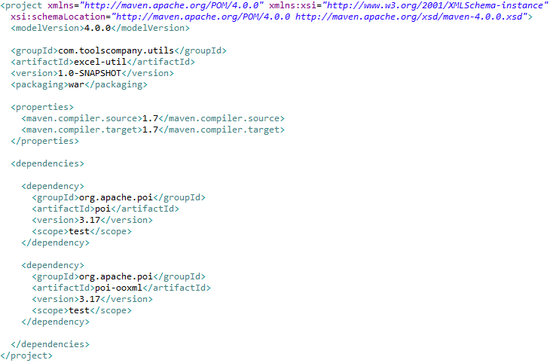

Slide 30
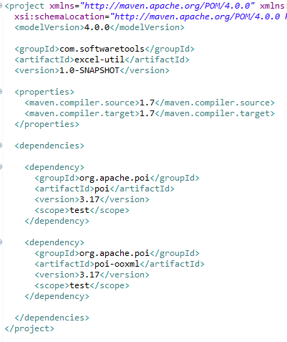
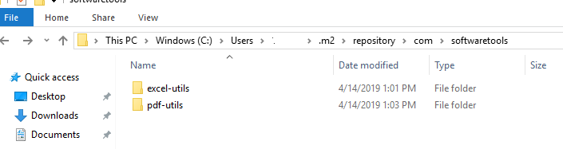
excel-utils jar file
groupID
artifactID
version
Dependencies

Slide 31
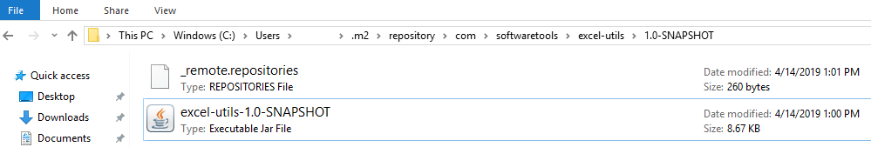
excel-utils jar file
groupID
artifactID
version
Dependencies

Slide 32
excel-utils jar file
groupID
artifactID
version
Dependencies
groupID
groupID
artifactID
artifactID
version
version
Dependencies
Dependencies
poi.jar
poi-ooxml.jar

Slide 33
How Maven Works
You will always call a mvn followed by phase
validate
compile
mvn install
mvn test
test
--- COMMON PHASE ---
This command executes each default lifecycle in order
package
verfiy
validate
compile
test
package
verfiy
install
install
deploy

Slide 34
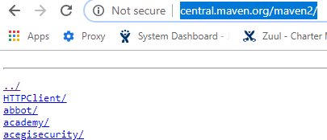
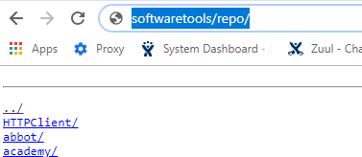
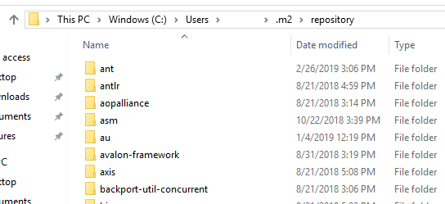
OR
REMOTE
REMOTE
MAVEN will look for dependencies in local .m2 repository first
IF artifact is not in local it downloads from remote and installs in local
LOCAL

Slide 35
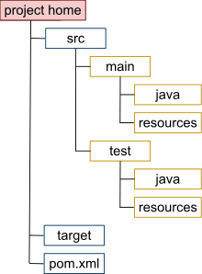
How Maven Works
mvn install
Reads the instructions from pom.xml
Gets the dependencies from local .m2 else from remote
Runs the various phases. Creates the target directory. It contains all the compiled classes, JAR files etc

Slide 36
Lets us add a plugin in pom
maven-javadoc-plugin
mvn javadoc:aggregate

Slide 37




CLONE

Slide 38
Create a user Linux
useradd tommy
passwd tommy

Slide 39
chmod
Used to set Read, Write and Execute permissions for different types of users.
chmod 755 filename.txt

Slide 40
chmod
USER
GRP
ALL
USER
GROUP
PERMISSIONS

Slide 41
chmod
chmod 755 filename.txt

Slide 42
Computer understands only 0’s and 1’s

Slide 43

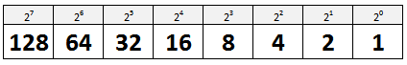
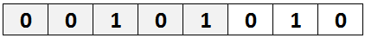
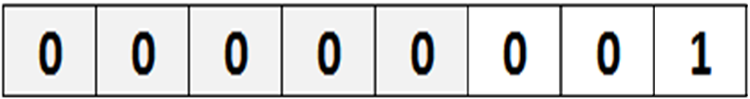
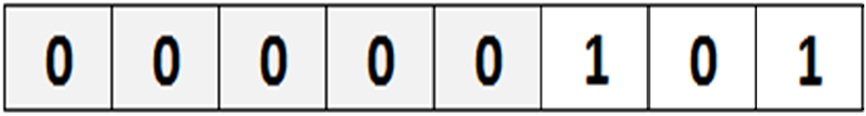
5
1
42

Slide 44
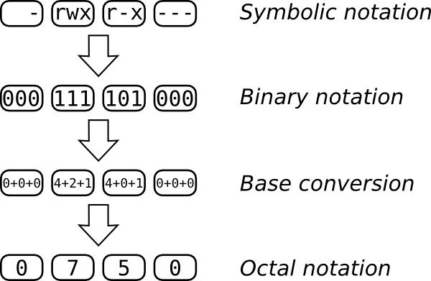
chmod
chmod 0750 filename.txt

Slide 45
Here it shows d means directory

Slide 46
Here it shows l means sym link

Slide 47
Chown
USER
GRP
ALL
USER
GROUP
PERMISSIONS
chown centos:tommy
Notes:
cat /etc/passwd | cut -d : -f1

Slide 48

The leading open source automation server

Slide 49
INSTALLATION & SETUP
Notes:
IMP XXX https://www.linuxtechi.com/install-configure-jenkins-on-centos-7-rhel-7/
yum install java
/bin/java
yum install maven
/bin/mvn
yum install git
/bin/git
JAVAHOME, MAVEN HOME and GIT EXECUTABLE PATH
http://ec2-34-221-200-12.us-west-2.compute.amazonaws.com:8080/configureTools/
EC2 PASSWORD LOGIN
https://aws.amazon.com/premiumsupport/knowledge-center/ec2-password-login/
JENKINS DOWNLOAD
https://jenkins.io/download/
-aG docker centos
echo "Current date is $(date)"
docker exec -it containername bash
Variables
NAME=Jitendra
echo $NAME
Jitendra
echo "Hello $NAME, Current date and time is $(date)"
Redirection to file
echo "Hello $NAME, Current date and time is $(date)" /tmp/info
**** Remember username and password for linux in AWS
vi script.sh
#!/bin/bash
echo Hello, $FIRSTNAME $LASTNAME
execute this script i will have an error
chmod +x script.sh
./script.sh
Hello,
./script.sh Jitendra A
#!/bin/bash
FIRSTNAME=$1
LASTNAME=$2
echo Hello, $FIRSTNAME $LASTNAME
How to we configure parameters rather than passing it to script commandline
Selete Parameters checkbox
String Params
List Params
Boolean params etc
SSH Plugin
Maven Integration
Selenium Integration
Git Integration
Hands On! Create your first Jenkins Job
Redirect your first Job's output
Learn how to execute a bash script from Jenkins
Add parameters to your Job
Learn how to create a Jenkins list parameter with your script
Add basic logic and boolean parameters
Install the Maven Plugin
Install the GIT Plugin
Learn how to clone a GIT/GITHUB repository from Jenkins
Execute test maven using Jenkins
When ever code is pushed to master trigger a maven job

Slide 50

Notes:
Jenkins ssh plugin
Jenkins ssh slave plugin
Jenkins dsl plugin
Create your first Jenkins Job
echo “Hello Jenkins“
echo "Current date is $(date)“
NAME=Jitendra
echo $NAME
echo "Hello $NAME, Current date and time is $(date)“
echo "Hello $NAME, Current date and time is $(date)" /tmp/info
Redirect your first Job's output
vi script.sh
#!/bin/bash
echo Hello, $FIRSTNAME $LASTNAME
execute this script i will have an error
chmod +x script.sh
./script.sh
Hello,
./script.sh Jitendra A
#!/bin/bash
FIRSTNAME=$1
LASTNAME=$2
echo Hello, $FIRSTNAME $LASTNAME
Jenkins With GIT
Jenkins With Maven
Manage Jenkins
Manage Nodes
New Node
Enter root dir in new node /var/lib/Jenkins
Enter Host 172.31.22.250
Enter Credentials – Go to add credentials page and add ssh key and user
Non verifying Vefification Strategy
Add a label
Launch Node - > Remote file system root /var/lib/jenkins does not exist
Go to the node and change permissions to chown –R centos:centos /var/lib/Jenkins
GitHub Integration Plugin
Manage Jenkins
Configure System
Published Jenkins URL http://ec2-3-17-76-189.us-east-2.compute.amazonaws.com:8080/
SAVE
https://github.com/project-blockbuster/DTHWebApplication
Settings
Webhooks
Payload URL http://ec2-18-221-190-221.us-east-2.compute.amazonaws.com:8080/github-webhook/
SAVE

Slide 51
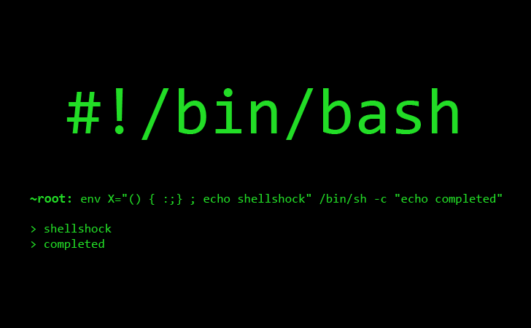

Slide 52
WHY JENKINS SLAVE
JOB1
JOB3
JOB5
JOB2
JOB4
JENKINS MASTER
TOO MUCH LOAD FOR ME TO HANDLE

Slide 53
JENKINS SLAVE
JOB1
JOB3
JOB5
JOB2
JOB4
JENKINS MASTER
JENKINS SLAVE
LET ME SHARE LOAD

Slide 54




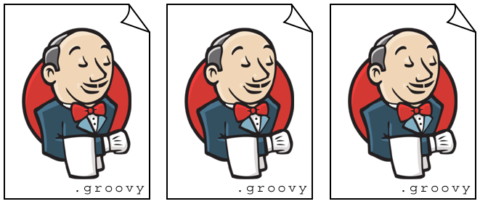
Jenkins Plugins

Slide 55

git clone using jenkins

Slide 56

git clone using jenkins
mvn test
mvn install
mvn deploy

Slide 57
Jenkins DSL Plugin
SEED JOB
CREATE JOBS FROM SEED JOB

Slide 58
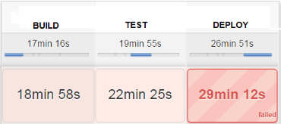
Jenkins Pipeline

Slide 59
pipeline {
/* insert Declarative Pipeline here */
}

Slide 60


agent
Where this entire PIPELINE should execute
Notes:
The agent section specifies where the entire Pipeline, or a specific stage, will execute in the Jenkins environment depending on where the agent section is placed.
The section must be defined at the top-level inside the pipeline block, but stage-level usage is optional.
https://jenkins.io/doc/book/pipeline/syntax/

Slide 61
stages
Where bulk of work is done

Slide 62
steps
series of one or more steps to be executed in a given stage

Slide 63
post
one or more additional steps that are run upon the completion of a Pipeline’s or stage’s run

Slide 64
environment
Sequence of key-value pairs
which will be defined as environment variables for the all steps,
or stage-specific steps

Slide 65
options
The options directive allows configuring Pipeline-specific options from within the Pipeline itself

Slide 66
parameters
List of parameters which a user should provide when triggering the Pipeline

Slide 67
triggers
Automated ways in which the Pipeline should be re-triggered

Slide 68
tools
Tools to auto-install and put on the PATH

Slide 69
input
The input directive on a stage allows you to prompt for input, using the input step
The stage will pause after any options have been applied before entering the stage.

Slide 70
when
Allows the Pipeline to determine whether the stage should be executed depending on the given condition.

Slide 71
Sequential Stages
Parallel Stages

Slide 72


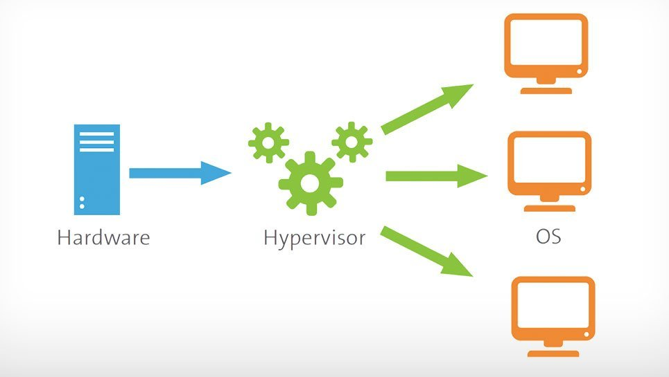



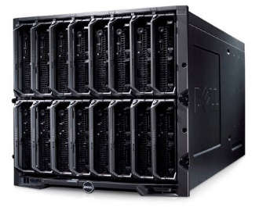
VIRTUAL MACHINE
16 GB RAM
300 TB HARD DISK
8 GB RAM
200 TB HARD DISK
8 GB RAM
100 TB HARD DISK
HYPERVISOR
CAPACITY
100 GB RAM
1000 TB HARD DISK
AVAILABLE
AVAILABLE
AVAILABLE
AVAILABLE
92 GB RAM
900 TB HARD DISK
86 GB RAM
700 TB HARD DISK
70 GB RAM
400 TB HARD DISK
100 GB RAM
1000 TB HARD DISK

Slide 73

Virtualization
Libs
App1
Libs
App2
Libs
App3
Operating System (OS)
Operating System (OS)
Operating System (OS)
HYPERVISOR

Slide 74



Containerization
Libs
App1
Libs
App2
Libs
App1
Libs
App2
OS
OS
OS
OS
Libs
App1
Libs
App2
Libs
App2
Operating System (OS)
Operating System (OS)
Operating System (OS)
HYPERVISOR

Slide 75

Docker - Ease Of Use
Jar files
App2
Jar files
App2
Jar files
App2
Jar files
App2
Java 1.7
Java 1.8
Operating System (OS)
Operating System (OS)
DEV MACHINE
PRD MACHINE
Notes:
https://docs.docker.com/engine/docker-overview/

Slide 76

Docker - Ease Of Use
Jar files
App2
Jar files
App2
Jar FIles
App2
Java 1.7
OS
Jar files
Jar files
App2
App2
Jar FIles
App2
Jar FIles
App2
Jar FIles
App2
Java 1.7
Java 1.8
Java 1.7
Java 1.7
OS
OS
Java 1.7
OS
Operating System (OS)
Operating System (OS)
DEV MACHINE
PRD MACHINE
Notes:
https://docs.docker.com/engine/docker-overview/
sudo yum install docker
service docker start
docker run -it centos bash
docker images
docker ps
docker ps –a
docker attach 58b07b100159
Ctrl + P + Q
Manage a user-defined bridge
docker network create my-net

Slide 77

Docker Engine

Slide 78
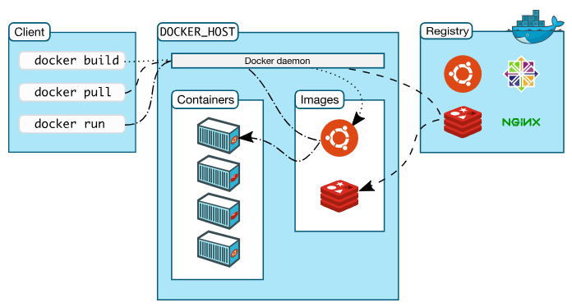


Architecture

Slide 79
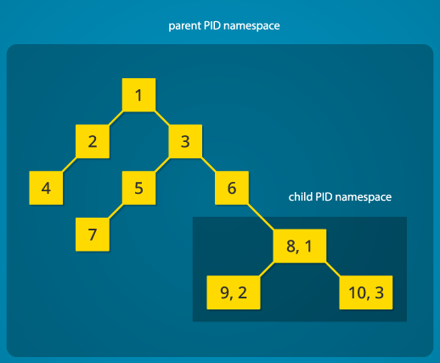
Namespaces
Feature of the Linux kernel that partitions kernel resources

Slide 80
Namespaces
Feature of the Linux kernel that partitions kernel resources
H
1
Firefox
HOST OS
Excel
2
3
…..
1009
Docker
1010
1011
Container PID
Container PID
1
1
2
3
2

Slide 81
Namespaces
The pid namespace: Process isolation (PID: Process ID).
The net namespace: Managing network interfaces (NET: Networking).
The ipc namespace: Managing access to IPC resources (IPC: InterProcess Communication).
The mnt namespace: Managing filesystem mount points (MNT: Mount).
The uts namespace: Isolating kernel and version identifiers. (UTS: Unix Timesharing System).

Slide 82
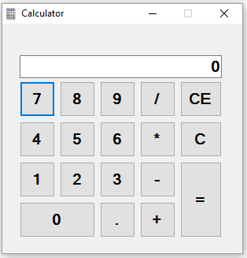
CGroups
Let us take an application
1 CPU
1 GB RAM
How does the system allocate the resources
It uses CGroups
Notes:
Cgroups allow you to allocate resources — such as CPU time, system memory, network bandwidth, or combinations of these resources

Slide 83
CGroups
Let us take an application
Libs
App1
1 CPU
1 GB RAM
OS
How does the system allocate the resources
It uses CGroups
Notes:
Cgroups allow you to allocate resources — such as CPU time, system memory, network bandwidth, or combinations of these resources

Slide 84
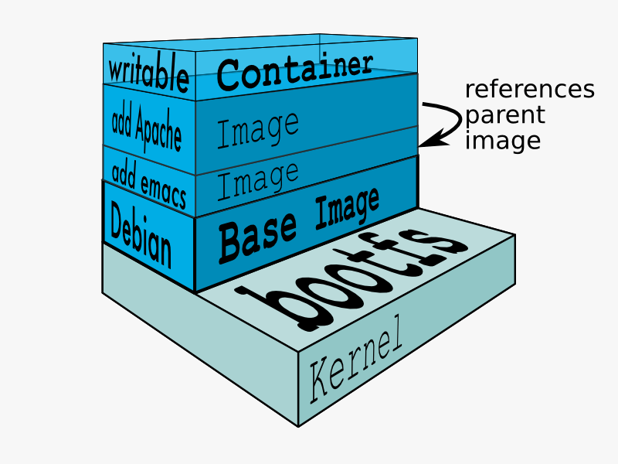
Union Mount

Slide 85
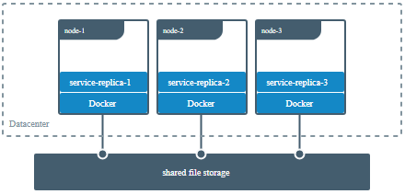

Slide 86
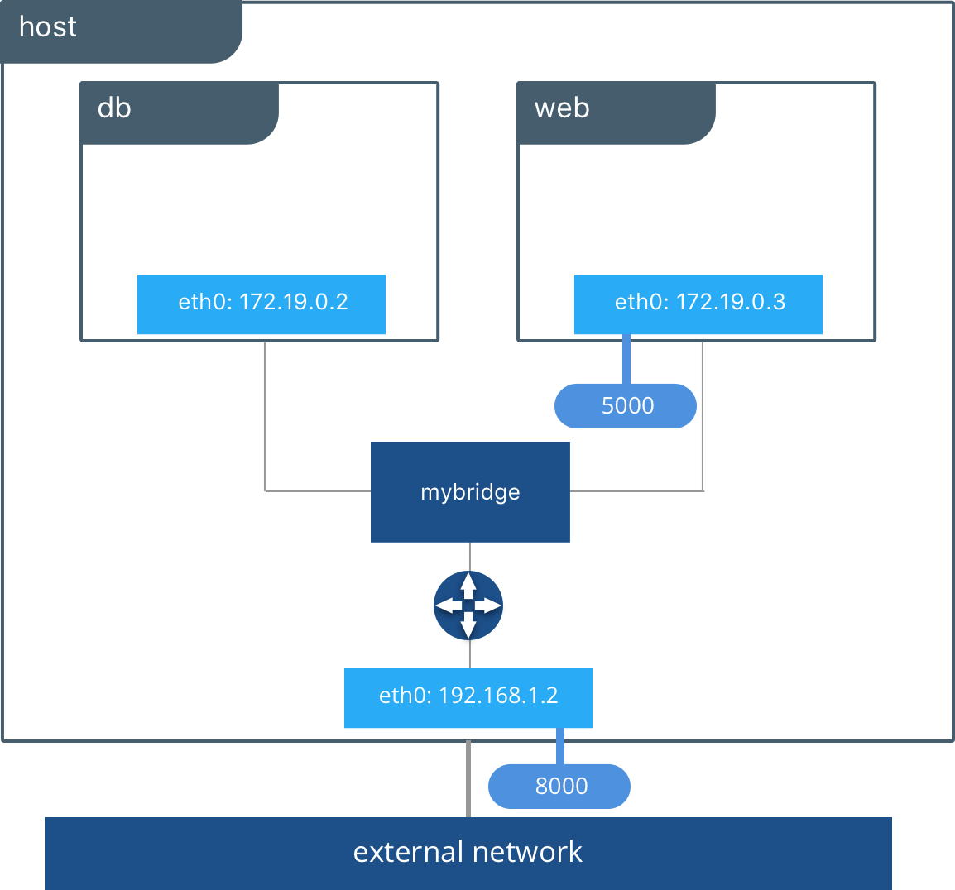
8080
Default Bridge Docker0
7070

Slide 87



8080
OldBridge
LondonBridge
7070

Slide 88
Libs
App1
Libs
App2
OS
OS

Slide 89
Libs
App1
Libs
App2
OS
OS
Libs
App1
Libs
App2
OS
OS

Slide 90
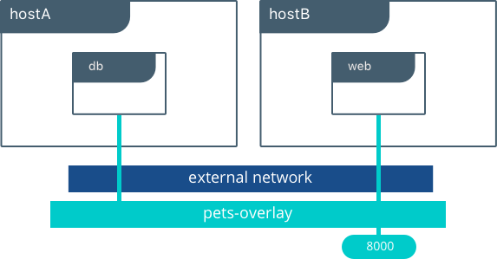
5000
dthoverlay

Slide 91
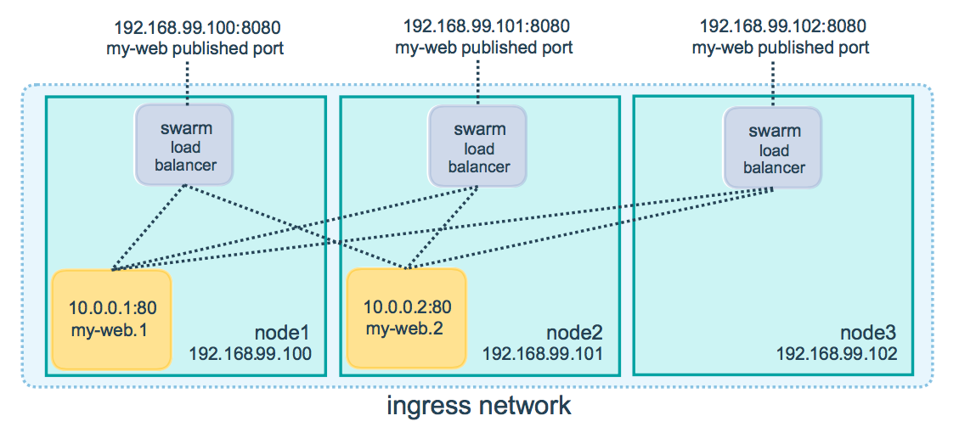

Slide 92
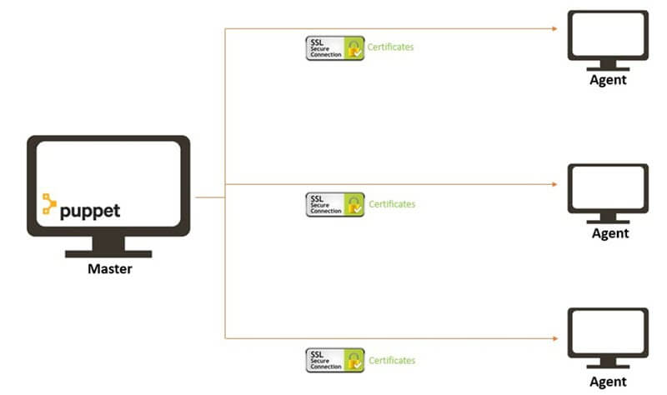
Sends Certificates
To master
Master
Signs the certificates

Slide 93
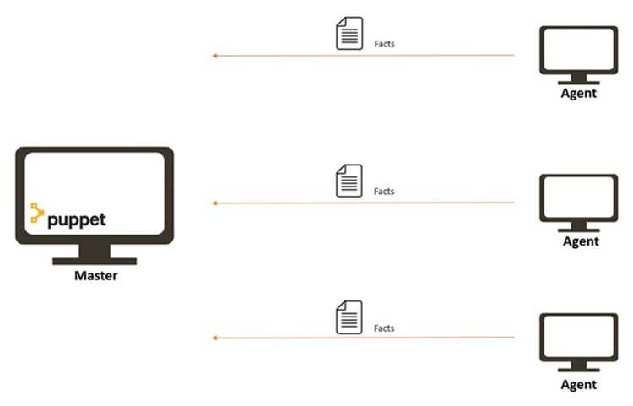

Slide 94
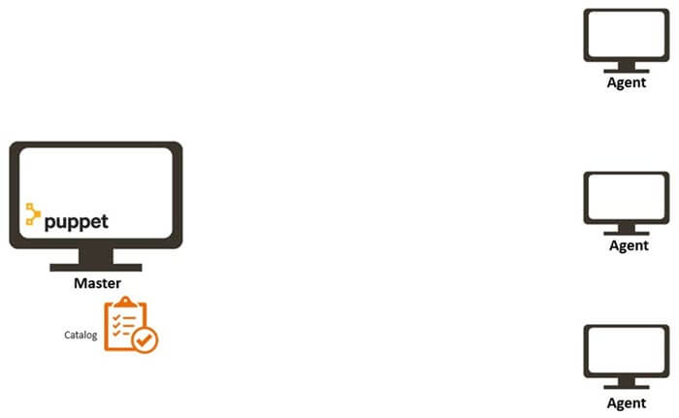

Slide 95
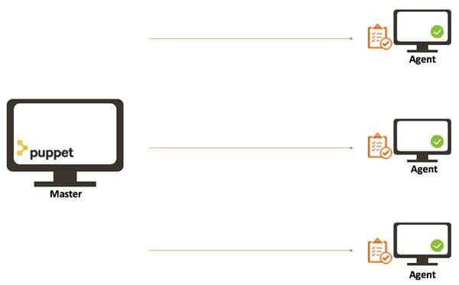

Slide 96
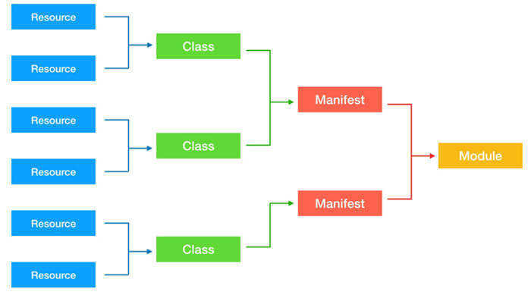

Slide 97



1
2
3
4
5
172.31.29.234
172.1.2.119
172.3.3.13
172.1.9.4
172.1.2.42
Need 5 virtual machines to be provisioned
172.31.29.234
Install OS Patch in All Systems
172.1.2.119
172.3.3.13
Deploy Application ex: leave system
172.1.9.4
172.1.2.42
Orchestration ex: Shutdown 2,4 while upgrading 1,3,5
Security Compliance ex: firewall request
…………

Slide 98



1
2
3
4
5
Need 5 virtual machines to be provisioned
Install OS Patch in All Systems
INVENTORY
Orchestration
ex: Shutdown 2,4 while upgrading 1,3,5
Deploy Application ex: leave system
PLAYBOOK
Security Compliance ex: firewall request

Slide 99


INVENTORY
HOW DO I KNOW THE INFORMATION ABOUT THE TARGET SYSTEMS
INVENTORY FILE
LINUX – SSH
WINDOWS – PowerShell Remoting

Slide 100
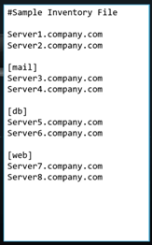
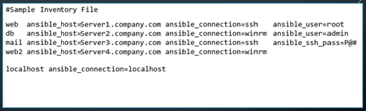
INVENTORY
Default Location: /etc/ansible/hosts
INVENTORY PARAMETERS
ansible_connection: ssh/winrm/localhost
ansible_port: 22/5986
ansible_user: root/administrator
ansible_ssh_pass: Password

Slide 101
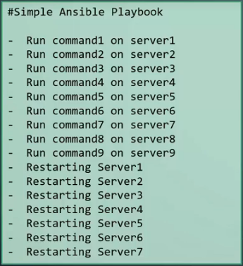
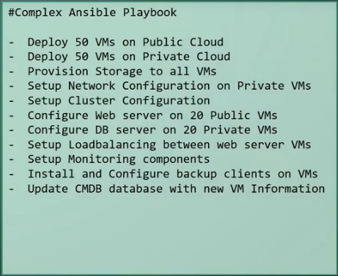
ANSIBLE PLAYBOOKS

Slide 102
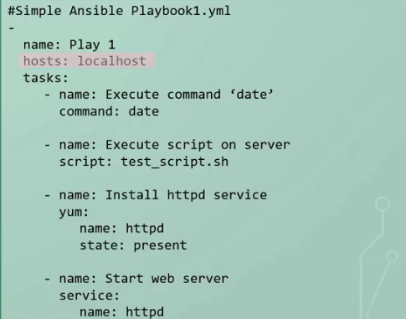
ANSIBLE Playbook
Playbook – A Single YAML File
Play – Defines a set of activities (tasks) to be run on hosts.
Task – An action to be performed on the host
Examples Include
Executing a command
Run a script
Install a package
Shutdown/Restart

Slide 103
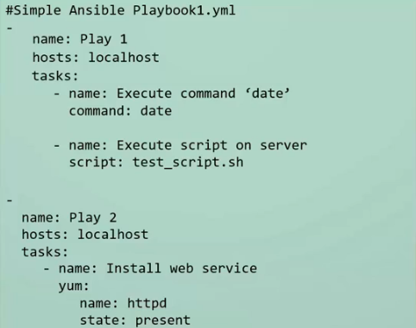
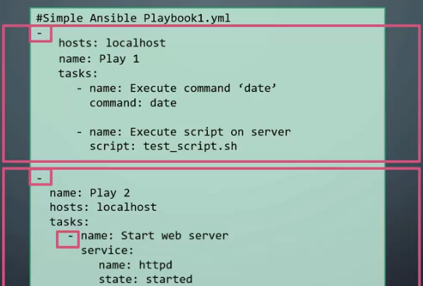
Ansible Playbook

Slide 104
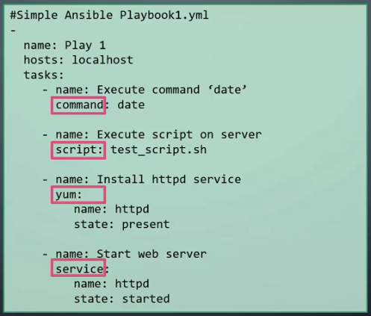
Ansible Modules in Playbook
Execute Ansible Playbook
Syntax: ansible-playbook <playbook file>
Ex: ansible-playbook myplay.yaml

Slide 105
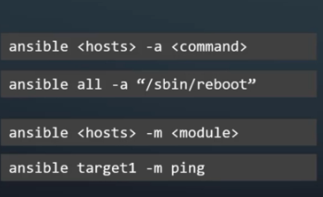
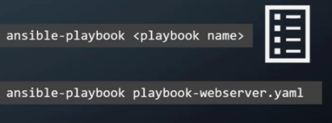
RUN ANSIBLE
ansible
ansible-playbook

Slide 106
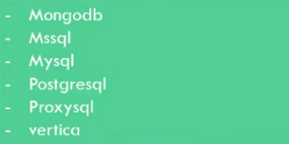
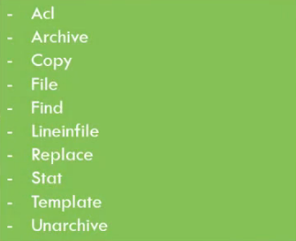




MODULES
System
Commands
Files
Database
Cloud
Windows
More..

Slide 107


Slide 108








VARIABLES

Slide 109




CONDITIONALS

Slide 110


LOOPS

Slide 111



Include Tasks & Variables

Slide 112



Include Tasks & Variables

Slide 113


Roles
Structure for project
How files and Folders are organized
ansible-galaxy init web

Slide 114


Slide 115




Slide 116


Slide 117


Slide 118

POD A
192.2.0.4
192.2.0.5
192.2.1.16
POD B1
POD B2
POD B3

Slide 119
POD A
10.2.0.5
SERVICE B
192.2.0.4
192.2.0.5
192.2.1.16
POD B1
POD B2
POD B3

Slide 120


